Slide 1
Hierarchies
Hierarchies

Slide 2
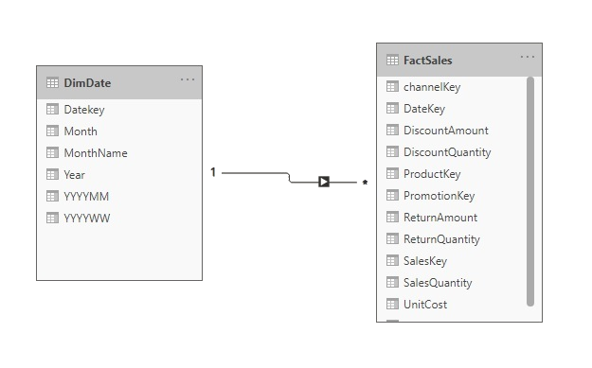
Hierarchies
Note: This workshop uses the Sales.xslx file located in the sources\Excel Sources folder
SalesExcel.xslx file and load both the DimDate and FactSales tables into the query editor.
Check that the relationship is established between DimDate and FactSales .

Slide 3
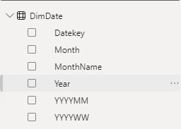
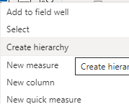
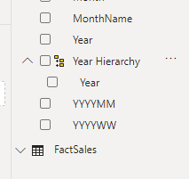
Hierarchies
Select the Year and right click, then apply "Create Hierarchy "
Notice the presence of a new field with a Year element in it

Slide 4
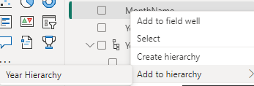
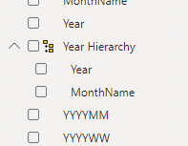
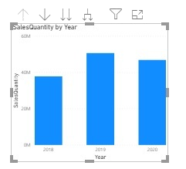
Hierarchies
Add MonthName just below Year , by right-clicking on it and adding it to the Year hierarchy .
Add a grouped columns visual, drag the newly created hierarchy to the axis X as well as Sales Quantity from the FactSales table to the axis Y .
Try exploring the navigation capabilities offered, represented by these icons.

Slide 5
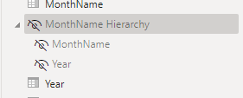
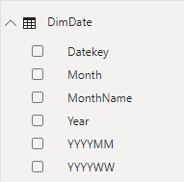
Hierarchies
Right - click the hierarchy and click Hide from report view .​
Note that the hierarchy is no longer visible in the interface visual .

Slide 6
THANKS
THANKS

